Slide 1
Week 4-5

Slide 2
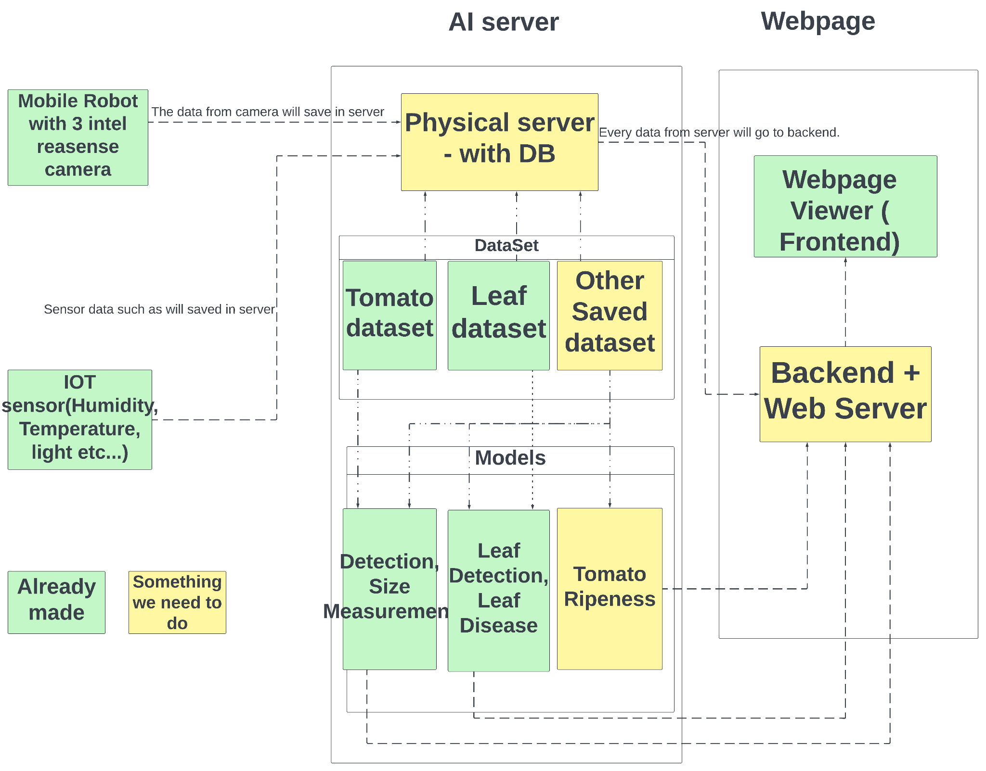
Project Diagram
https://lucid.app/lucidchart/263e36d9-0b68-4117-8493-b5d9dc19e0e8/edit?viewport_loc=-2976%2C224%2C5929%2C2617%2C0_0&invitationId=inv_d18a7dc6-119a-49da-b63a-71edf3c5463c

Slide 3
Things to Do
Make AI server(physical server)
Web backend with DB
Use web frontend
Connect IOT sensor and send data to server
make or use model for tomato ripeness

Slide 4
To do week 4-5
Continue literature review on Flask (Backend), Vue and React (Frontend)
Continue literature review on estimate tomato ripeness, AI server.
Using smart farm kit (ESP32) to check every sensor works
Get data from sensor and show on backend or server.
Make Diagram of project structure

Slide 5
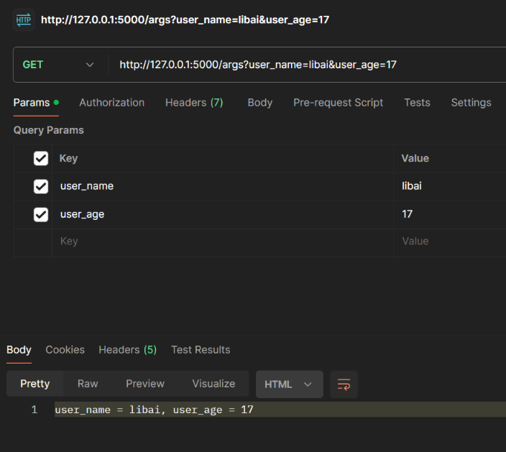
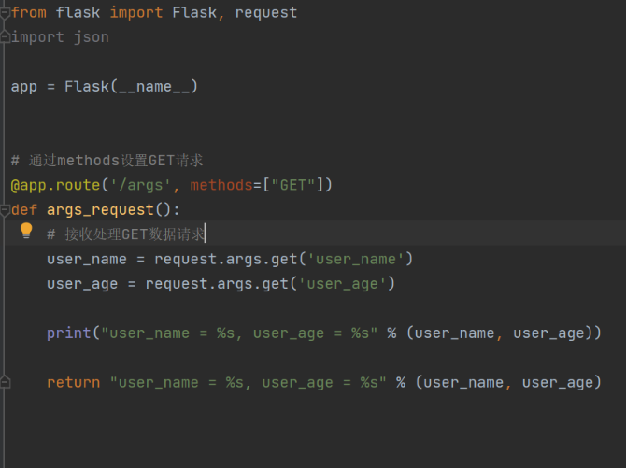
Flask Development: Get Request Example
We create a simple app.py file as our backend server and create a @app.route(‘/args, methods=[“GET”]’) and a def method to modified our get request and saving data.
Using postman to make a request

Slide 6
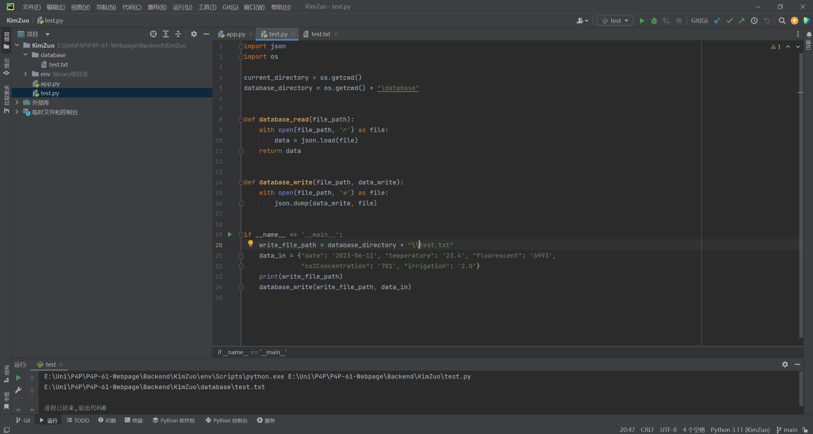
Using OS and Json to write or read database
Here we create a test.py file to test the functionality of the json.load and json.dump, so we can implement this function to our GET request so the backend can get information from user and write into our database

Slide 7
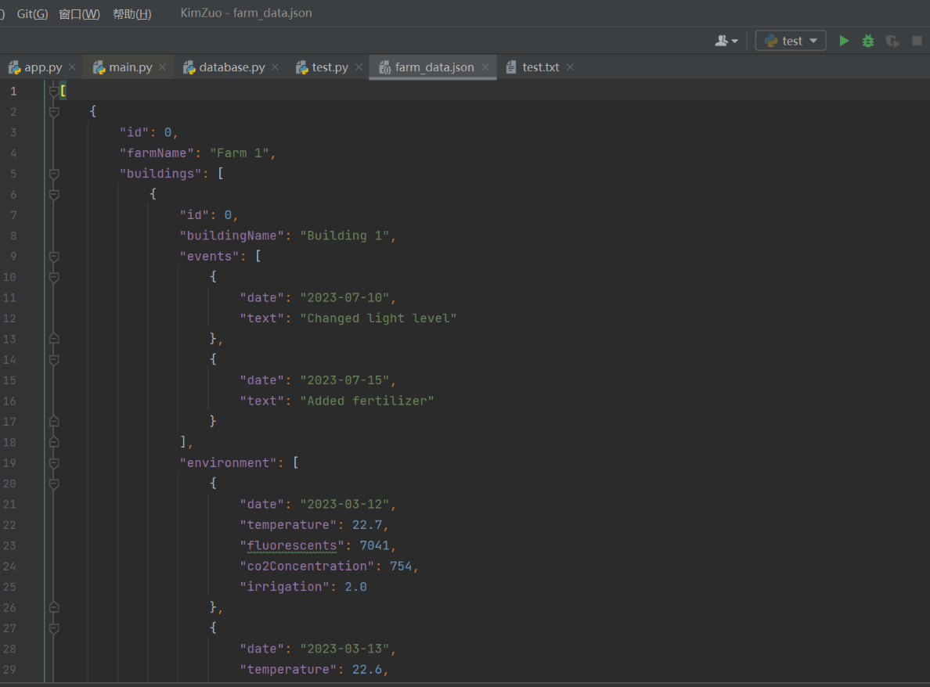
Store Fake Data using json
import json
import os
database_directory = os.getcwd() + "\database\\farm_data.json"
# Original data from data.ts
data = [
{
"id": 0,
"farmName": "Farm 1",
"buildings": [
{
"id": 0,
"buildingName": "Building 1",
"events": [
{"date": "2023-07-10", "text": "Changed light level"},
{"date": "2023-07-15", "text": "Added fertilizer"}
],
"environment": [
{"date": "2023-03-12", "temperature": 22.7, "fluorescents": 7041, "co2Concentration": 754,
"irrigation": 2.0},
{"date": "2023-03-13", "temperature": 22.6, "fluorescents": 6992, "co2Concentration": 754,
"irrigation": 2.1},
# More environment data...
],
"data": [
{"date": "2023-03-12", "area": 613, "fruitlets": 0, "height": 192, "leaves": 5, "volume": 505,
"width": 46},
{"date": "2023-03-13", "area": 616, "fruitlets": 0, "height": 205, "leaves": 11, "volume": 495,
"width": 54},
# More data...
],
"plots": [
{
"id": 0,
"plotName": "Plot A1",
# Plot A1 data...
},
# More plots...
]
},
# More buildings...
]
},
# More farms...
]
# Write data to a text file in JSON format
with open(database_directory, "w") as outfile:
json.dump(data, outfile, indent=4)
print("Data successfully stored in 'farm_data.json' file.")

Slide 8
IOT sensor with MySQL
Send data to MySQL server through WiFi.

